Slide 1


Fundamentals of Management
Eleventh Edition
Chapter 4
Making Decisions
Copyright © 2020, 2017, 2015 Pearson Education, Inc. All Rights Reserved
Notes:
If this PowerPoint presentation contains mathematical equations, you may need to check that your computer has the following installed:
1) Math Type Plugin
2) Math Player (free versions available)
3) NVDA Reader (free versions available)

Slide 2
Learning Objectives
4.1 Describe the decision-making process.
4.2 Explain the three approaches managers can use to make decisions.
4.3 Describe the types of decisions and decision-making conditions managers face.
4.4 Discuss group decision making.
4.5 Discuss contemporary issues in managerial decision making.

Slide 3
Learning Objective 4.1
Describe the decision-making process.

Slide 4
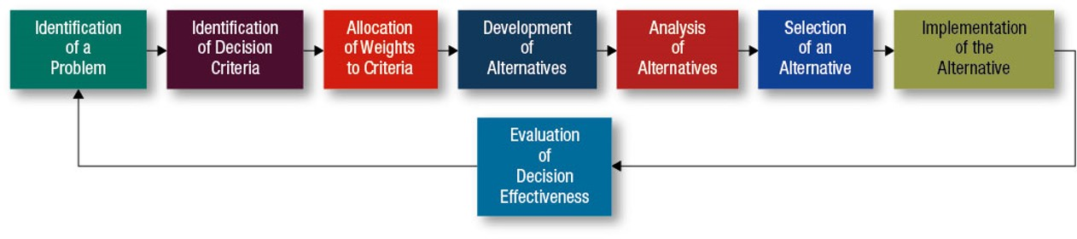
The Decision-Making Process
Exhibit 4.1 The Decision-Making Process

Slide 5
Identifying a Decision Problem
Problem:
a discrepancy between an existing and a desired state of affairs.

Slide 6

Identifying Decision Criteria
Relevant Factors:
Price
Model
Size
Manufacturer
Options
Repair record

Slide 7
Weighting Criteria
Most important criterion assigned a weight of 10
Other weights assigned against this standard
Exhibit 4.2 Important Criteria and Weights in a Car-Buying Decision
CRITERION | WEIGHT
Price | 10
Interior comfort | 8
Durability | 5
Repair record | 5
Performance | 3
Handling | 1

Slide 8
Developing Alternatives (1 of 2)
Alternatives
Jeep Compass
Ford Focus
Hyundai Elantra
Ford Fiesta S E S
Volkswagen Golf
Toyota Prius
Mazda 3 M T

Slide 9
Developing Alternatives (2 of 2)
Kia Soul
B M W i 3
Nissan Cube
Toyota Camry
Honda Fit Sport M T

Slide 10
Analyzing Alternatives
Exhibit 4.3 Assessment of Possible Car Alternatives
ALTERNATIVES | INITIAL PRICE | INTERIOR COMFORT | DURABILITY | REPAIR RECORD | PERFORMANCE | HANDLING | TOTAL
Jeep Compass | 2 | 10 | 8 | 7 | 5 | 5 | 37
Ford Focus | 9 | 6 | 5 | 6 | 8 | 6 | 40
Hyundai Elantra | 8 | 5 | 6 | 6 | 4 | 6 | 35
Ford Fiesta S E S | 9 | 5 | 6 | 7 | 6 | 5 | 38
Volkswagen Golf G T I | 5 | 6 | 9 | 10 | 7 | 7 | 44
Toyota Prius | 10 | 5 | 6 | 4 | 3 | 3 | 31
Mazda 3 M T | 4 | 8 | 7 | 6 | 8 | 9 | 42
Kia Soul | 7 | 6 | 8 | 6 | 5 | 6 | 38
BMW i 3 | 9 | 7 | 6 | 4 | 4 | 7 | 37
Nissan Cube | 5 | 8 | 5 | 4 | 10 | 10 | 42
Toyota Camry | 6 | 5 | 10 | 10 | 6 | 6 | 43
Honda Fit Sport M T | 8 | 6 | 6 | 5 | 7 | 8 | 40

Slide 11

Selecting the Best Alternative (1 of 2)
Exhibit 4.4 Evaluation of Car Alternatives: Assessment Criteria
Criteria Weight
ALTERNATIVES | INITIAL PRICE | INITIAL PRICE [10] | INTERIOR COMFORT | INTERIOR COMFORT [8] | DURABILITY | DURABILITY [5] | REPAIR RECORD | REPAIR RECORD [5] | PERFORMANCE | PERFORMANCE [3] | HANDLING | HANDLING [1] | TOTAL
Jeep Compass | 2 | 20 | 10 | 80 | 8 | 40 | 7 | 35 | 5 | 15 | 5 | 5 | 195
Ford Focus | 9 | 90 | 6 | 48 | 5 | 25 | 6 | 30 | 8 | 24 | 6 | 6 | 223
Hyundai Elantra | 8 | 80 | 5 | 40 | 6 | 30 | 6 | 30 | 4 | 12 | 6 | 6 | 198
Ford Fiesta S E S | 9 | 90 | 5 | 40 | 6 | 30 | 7 | 35 | 6 | 18 | 5 | 5 | 218
Volkswagen Golf G T I | 5 | 50 | 6 | 48 | 9 | 45 | 10 | 50 | 7 | 21 | 7 | 7 | 221
Toyota Prius | 10 | 100 | 5 | 40 | 6 | 30 | 4 | 20 | 3 | 9 | 3 | 3 | 202

Slide 12
Selecting the Best Alternative (2 of 2)
Exhibit 4.4 Evaluation of Car Alternatives: Assessment Criteria
Criteria Weight
(continued)
ALTERNATIVES | INITIAL PRICE | INITIAL PRICE [10] | INTERIOR COMFORT | INTERIOR COMFORT [8] | DURABILITY | DURABILITY [5] | REPAIR RECORD | REPAIR RECORD [5] | PERFORMANCE | PERFORMANCE [3] | HANDLING | HANDLING [1] | TOTAL
Mazda 3 M T | 4 | 40 | 8 | 64 | 7 | 35 | 6 | 30 | 8 | 24 | 9 | 9 | 202
Kia Soul | 7 | 70 | 6 | 48 | 8 | 40 | 6 | 30 | 5 | 15 | 6 | 6 | 209
BMW i 3 | 9 | 90 | 7 | 56 | 6 | 30 | 4 | 20 | 4 | 12 | 7 | 7 | 215
Nissan Cube | 5 | 50 | 8 | 64 | 5 | 25 | 4 | 20 | 10 | 30 | 10 | 10 | 199
Toyota Camry | 6 | 60 | 5 | 40 | 10 | 50 | 10 | 50 | 6 | 18 | 6 | 6 | 224
Honda Fit Sport M T | 8 | 80 | 6 | 48 | 6 | 30 | 5 | 25 | 7 | 21 | 8 | 8 | 212

Slide 13
Implementing the Decision
Decision implementation:
putting a decision into action.

Slide 14
Evaluating the Decision
Appraising the outcome of the decision
Was the problem resolved?

Slide 15
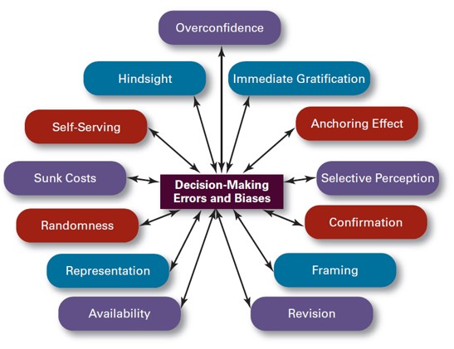
Common Decision-Making Errors and Biases
Exhibit 4.5 Common Decision-Making Errors and Biases

Slide 16
Learning Objective 4.2
Explain the three approaches managers can use to make decisions.

Slide 17
Decisions Managers Make (1 of 4)
Exhibit 4.6 Decisions Managers May Make
Planning
What are the organization’s long-term objectives?
What strategies will best achieve those objectives?
What should the organization’s short-term objectives be?
How difficult should individual goals be?

Slide 18
Decisions Managers Make (2 of 4)
Exhibit 4.6 Decisions Managers May Make (continued)
Leading
How do I handle unmotivated employees?
What is the most effective leadership style in a given situation?
How will a specific change affect worker productivity?
When is the right time to stimulate conflict?

Slide 19
Decisions Managers Make (3 of 4)
Exhibit 4.6 Decisions Managers May Make (continued)
Organizing
How many employees should I have report directly to me?
How much centralization should there be in an organization?
How should jobs be designed?
When should the organization implement a different structure?

Slide 20
Decisions Managers Make (4 of 4)
Exhibit 4.6 Decisions Managers May Make (continued)
Controlling
What activities in the organization need to be controlled?
How should those activities be controlled?
When is a performance deviation significant?
What type of management information system should the organization have?
Source: Robbins, Stephen P., Coulter, Mary, Management, 13th E d., © 2016, p. 45. Reprinted and electronically reproduced by permission of Pearson Education, Inc., New York, N Y.

Slide 21

Rational Model
Rational decision making”
choices that are consistent and value-maximizing within specified constraints.
Rationality is not a very realistic approach.

Slide 22

Bounded Rationality
Satisfice
Escalation of commitment
A more realistic approach.

Slide 23
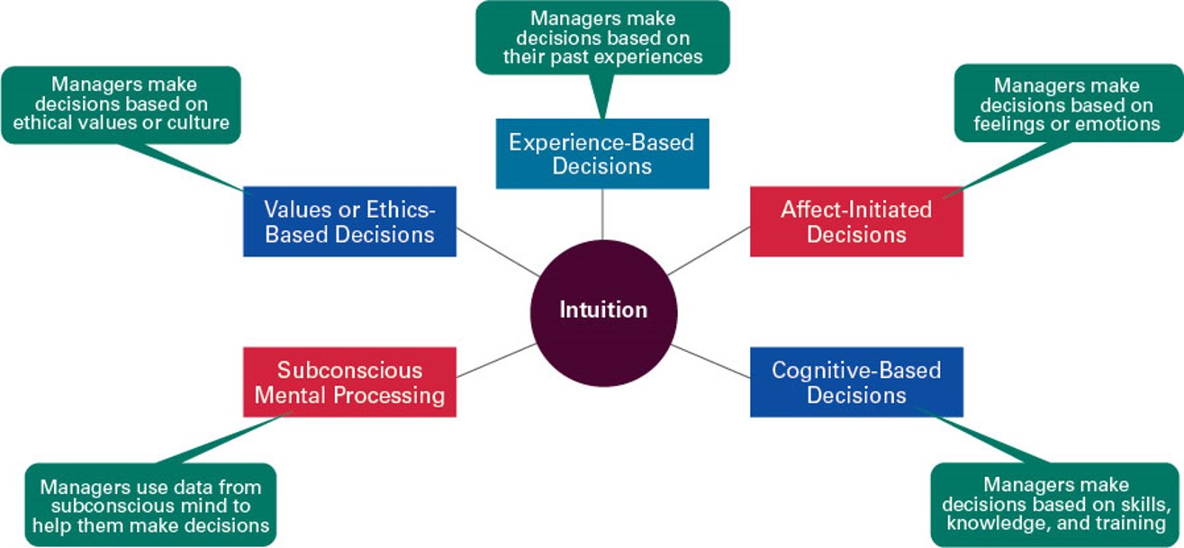
Intuitive Decision Making (1 of 2)
Exhibit 4.7 What Is Intuition?

Slide 24
Intuitive Decision Making (2 of 2)
Sources: Based on J. Evans, “Intuition and Reasoning: A Dual-Process Perspective,” Psychological Inquiry, October–December 2010, p p. 313–26; T. Betsch and A. Blockner, “Intuition in Judgment and Decision Making: Extensive Thinking Without Effort,” Psychological Inquiry, October–December 2010, p p. 279–94; R. Lange and J. Houran, “A Transliminal View of Intuitions in the Workplace,” North American Journal of Psychology, 12, no. 3 (2010), p p. 501–16; E. Dane and M. G. Pratt, “Exploring Intuition and Its Role in Managerial Decision Making,” Academy of Management Review, January 2007, p p. 33–54; M. H. Bazerman and D. Chugh, “Decisions without Blinders,” Harvard Business Review, January 2006, p p.88–97; C. C. Miller and R. D. Ireland, “Intuition in Strategic Decision Making: Friend or Foe in the Fast- Paced 21st Century,” Academy of Management Executive, February 2005, p p. 19–30; E. Sadler-Smith and E. Shefy, “The Intuitive Executive: Understanding and Applying ‘Gut Feel’ in Decision-Making,” Academy of Management Executive, November 2004, p p. 76–91; and L. A. Burke and M. K. Miller, “Taking the Mystery Out of Intuitive Decision Making,” Academy of Management Executive, October 1999, p p. 91–99.

Slide 25
Learning Objective 4.3
Describe the types of decisions and decision-making conditions that managers face.

Slide 26
Types of Problems
Structured problem:
straightforward, familiar, easily defined.
Unstructured problem:
new or unusual for which information is ambiguous or incomplete.

Slide 27

Types of Decisions (1 of 2)
Programmed:
repetitive decisions that can be handled using a routine approach.

Slide 28
Types of Decisions (2 of 2)
Nonprogrammed:
A unique and nonrecurring decision that requires a custom made solution.

Slide 29
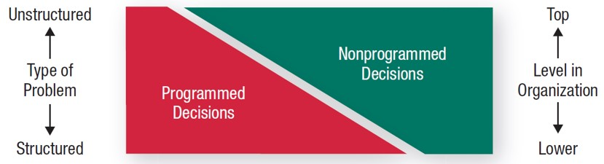
Problems, Decision Types, and Organizational Levels
Exhibit 4.8 Types of Problems, Types of Decisions, and Organizational Level

Slide 30
Decision-Making Conditions
Certainty
Risk
Uncertainty

Slide 31
Learning Objective 4.4
Discuss group decision making.

Slide 32
How Do Groups Make Decisions?
Decisions are often made by groups representing the people who will be most affected by those decisions.
Committees
Task forces
Review panels
Work teams

Slide 33
Advantages of Group Decision Making
Diversity of experiences/perspectives
More complete information
More alternatives generated
Increased acceptance of solution
Increased legitimacy

Slide 34
Disadvantages of Group Decision Making
Time-consuming
Minority domination
Ambiguous responsibility
Pressures to conform

Slide 35
Groupthink
When a group exerts extensive pressure on an individual to withhold his or her different views in order to appear to be in agreement.
What it does
How it occurs
How to minimize it

Slide 36
When Are Groups Most Effective?
Individual
Faster decision making
More efficient use of work hours
Group
More accurate decisions
More creative
More heterogeneous representation
Greater acceptance of final solution

Slide 37
Improving Group Decision Making
Make group decisions more creative by:
Brainstorming
The nominal group technique
Electronic meetings

Slide 38
Learning Objective 4.5
Discuss contemporary issues in managerial decision making.

Slide 39
Contemporary Issues (1 of 4)
National culture:
influences the way decisions are made and the degree of risk involved.

Slide 40
Contemporary Issues (2 of 4)
Creativity lets the decision maker:
Understand a problem more fully
See problems others can’t
Identify all viable alternatives

Slide 41
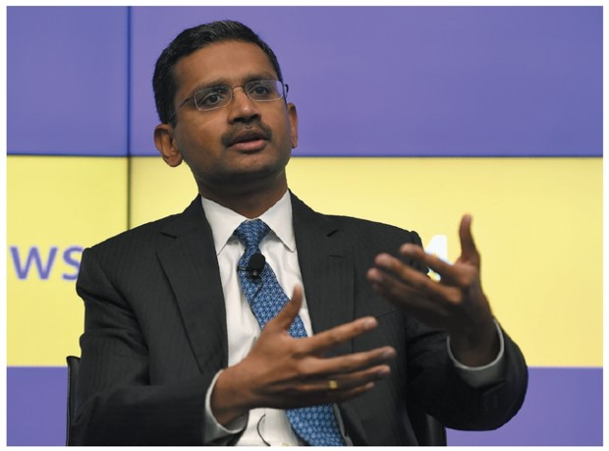
Contemporary Issues (3 of 4)
Design thinking:
approaching management problems as designers approach design problems.

Slide 42
Contemporary Issues (4 of 4)
Big Data:
the vast amounts of quantifiable information that can be analyzed by highly sophisticated data processing.
Changing the way managers make decisions.

Slide 43

Copyright
This work is protected by United States copyright laws and is provided solely for the use of instructors in teaching their courses and assessing student learning. Dissemination or sale of any part of this work (including on the World Wide Web) will destroy the integrity of the work and is not permitted. The work and materials from it should never be made available to students except by instructors using the accompanying text in their classes. All recipients of this work are expected to abide by these restrictions and to honor the intended pedagogical purposes and the needs of other instructors who rely on these materials.

